Slide 1


Vienna DevOps Meetup
Pulumi: Kickstarting Your Journey to Modern Infrastructure Automation

Slide 2

Hello!
I am Engin Diri,
Working at Pulumi as Customer Experience Architect
Cloud Transformation and Enablement
Continuous everything…

Slide 3
Agenda
Introduction
Pulumi High Level View
Pulumi Template / Cloud /Policy as Code
Demo

Slide 4
Disclaimer
Everything in this presentation is either OSS or part of a free tier!

Slide 5
Introduction

Slide 6




















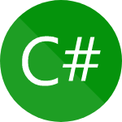








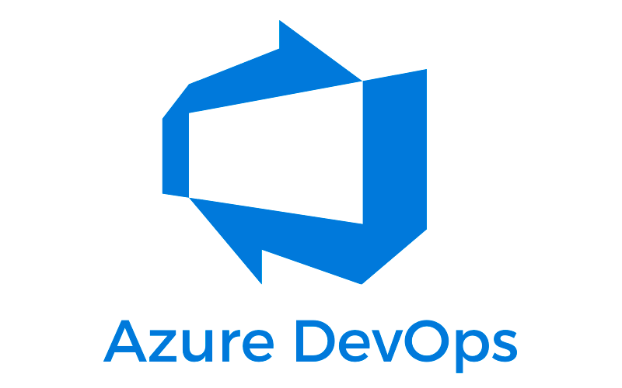










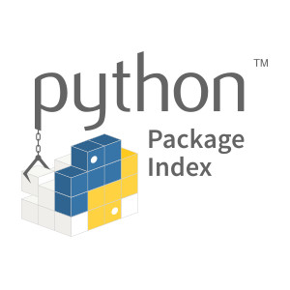







































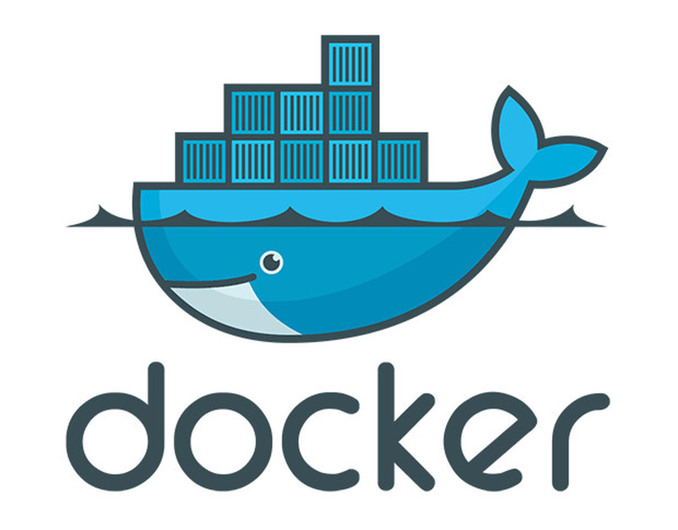













Your Cloud, Your Language, Your Way
IDEs
Tools
Packages
Foundation
Data
Network
Architecture
SCM
Team
Others
Build
Deploy
Manage

Slide 7









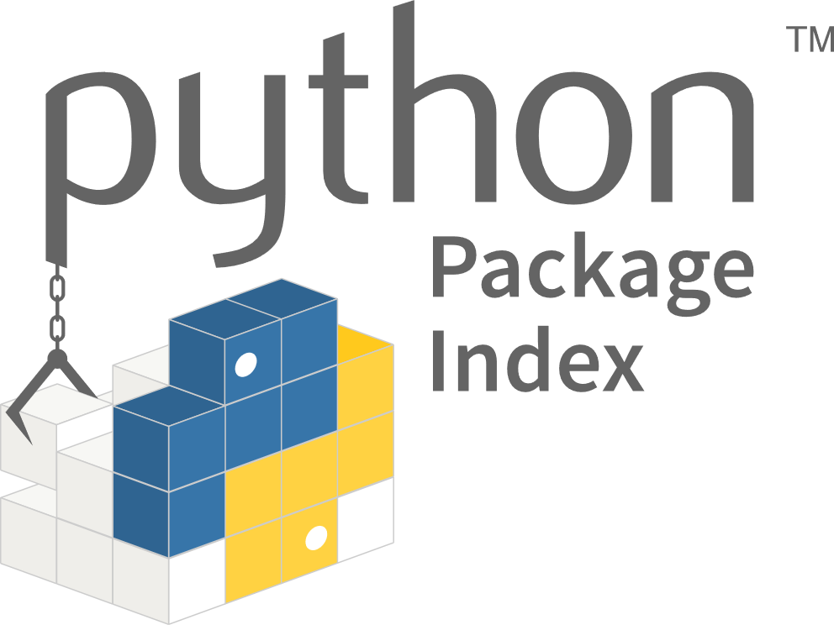





















Pulumi: The Cloud Engineering Platform
Create Orchestration Workflows and Control Planes
Pulumi Automation API
Pulumi CLI
Author in Any Language
Pulumi Universal Infrastructure as Code Engine
Consume in Any Language
Pulumi SDK
Pulumi CrossGuard
Pulumi CrossWalk
Pulumi Multi- language Packages
Pulumi CrossCode
Use or Convert from Any Format
Deploy to Any Cloud
CDK constructs
K8s YAML CRD Helm
HCL ARM CFN templates
Pulumi Provider
Foundation
Data
Network
Others
Infrastructure Delivery Pipeline
IDE
Test Frameworks
Source Control
Integration Testing
Pulumi Service (SaaS or Self-hosted)
Federated Identity
Secrets Management
RBAC
Policy Enforcement
Audit Logs

Slide 8
Pulumi: The Cloud Engineering Platform
Create Orchestration Workflows and Control Planes
Pulumi Automation API
Pulumi CLI
Author in Any Language
Pulumi Universal Infrastructure as Code Engine
Consume in Any Language
Pulumi SDK
Pulumi CrossGuard
Pulumi CrossWalk
Pulumi Multi- language Packages
Pulumi CrossCode
Use or Convert from Any Format
Deploy to Any Cloud
CDK constructs
K8s YAML CRD Helm
HCL ARM CFN templates
Pulumi Provider
Foundation
Data
Network
Others
Infrastructure Delivery Pipeline
IDE
Test Frameworks
Source Control
Integration Testing
Pulumi Service (SaaS or Self-hosted)
Federated Identity
Secrets Management
RBAC
Policy Enforcement
Audit Logs
Notes:
https://www.pulumi.com/crosscode/

Slide 9
Pulumi: The Cloud Engineering Platform
Create Orchestration Workflows and Control Planes
Pulumi Automation API
Pulumi CLI
Author in Any Language
Pulumi Universal Infrastructure as Code Engine
Consume in Any Language
Pulumi SDK
Pulumi CrossGuard
Pulumi CrossWalk
Pulumi Multi- language Packages
Pulumi CrossCode
Use or Convert from Any Format
Deploy to Any Cloud
CDK constructs
K8s YAML CRD Helm
HCL ARM CFN templates
Pulumi Provider
Foundation
Data
Network
Others
Infrastructure Delivery Pipeline
IDE
Test Frameworks
Source Control
Integration Testing
Pulumi Service (SaaS or Self-hosted)
Federated Identity
Secrets Management
RBAC
Policy Enforcement
Audit Logs
Notes:
https://www.pulumi.com/crosscode/

Slide 10
Pulumi: The Cloud Engineering Platform
Create Orchestration Workflows and Control Planes
Pulumi Automation API
Pulumi CLI
Author in Any Language
Pulumi Universal Infrastructure as Code Engine
Consume in Any Language
Pulumi SDK
Pulumi CrossGuard
Pulumi CrossWalk
Pulumi Multi- language Packages
Pulumi CrossCode
Use or Convert from Any Format
Deploy to Any Cloud
CDK constructs
K8s YAML CRD Helm
HCL ARM CFN templates
Pulumi Provider
Foundation
Data
Network
Others
Infrastructure Delivery Pipeline
IDE
Test Frameworks
Source Control
Integration Testing
Pulumi Service (SaaS or Self-hosted)
Federated Identity
Secrets Management
RBAC
Policy Enforcement
Audit Logs
Notes:
https://www.pulumi.com/crosscode/

Slide 11
Pulumi: The Cloud Engineering Platform
Create Orchestration Workflows and Control Planes
Pulumi Automation API
Pulumi CLI
Author in Any Language
Pulumi Universal Infrastructure as Code Engine
Consume in Any Language
Pulumi SDK
Pulumi CrossGuard
Pulumi CrossWalk
Pulumi Multi- language Packages
Pulumi CrossCode
Use or Convert from Any Format
Deploy to Any Cloud
CDK constructs
K8s YAML CRD Helm
HCL ARM CFN templates
Pulumi Provider
Foundation
Data
Network
Others
Infrastructure Delivery Pipeline
IDE
Test Frameworks
Source Control
Integration Testing
Pulumi Service (SaaS or Self-hosted)
Federated Identity
Secrets Management
RBAC
Policy Enforcement
Audit Logs
Notes:
https://www.pulumi.com/crosscode/

Slide 12
Pulumi: The Cloud Engineering Platform
Create Orchestration Workflows and Control Planes
Pulumi Automation API
Pulumi CLI
Author in Any Language
Pulumi Universal Infrastructure as Code Engine
Consume in Any Language
Pulumi SDK
Pulumi CrossGuard
Pulumi CrossWalk
Pulumi Multi- language Packages
Pulumi CrossCode
Use or Convert from Any Format
Deploy to Any Cloud
CDK constructs
K8s YAML CRD Helm
HCL ARM CFN templates
Pulumi Provider
Foundation
Data
Network
Others
Infrastructure Delivery Pipeline
IDE
Test Frameworks
Source Control
Integration Testing
Pulumi Service (SaaS or Self-hosted)
Federated Identity
Secrets Management
RBAC
Policy Enforcement
Audit Logs
Notes:
https://www.pulumi.com/crosscode/

Slide 13
Pulumi: The Cloud Engineering Platform
Create Orchestration Workflows and Control Planes
Pulumi Automation API
Pulumi CLI
Author in Any Language
Pulumi Universal Infrastructure as Code Engine
Consume in Any Language
Pulumi SDK
Pulumi CrossGuard
Pulumi CrossWalk
Pulumi Multi- language Packages
Pulumi CrossCode
Use or Convert from Any Format
Deploy to Any Cloud
CDK constructs
K8s YAML CRD Helm
HCL ARM CFN templates
Pulumi Provider
Foundation
Data
Network
Others
Infrastructure Delivery Pipeline
IDE
Test Frameworks
Source Control
Integration Testing
Pulumi Service (SaaS or Self-hosted)
Federated Identity
Secrets Management
RBAC
Policy Enforcement
Audit Logs
Notes:
https://www.pulumi.com/crosscode/

Slide 14
Pulumi: The Cloud Engineering Platform
Create Orchestration Workflows and Control Planes
Pulumi Automation API
Pulumi CLI
Author in Any Language
Pulumi Universal Infrastructure as Code Engine
Consume in Any Language
Pulumi SDK
Pulumi CrossGuard
Pulumi CrossWalk
Pulumi Multi- language Packages
Pulumi CrossCode
Use or Convert from Any Format
Deploy to Any Cloud
CDK constructs
K8s YAML CRD Helm
HCL ARM CFN templates
Pulumi Provider
Foundation
Data
Network
Others
Infrastructure Delivery Pipeline
IDE
Test Frameworks
Source Control
Integration Testing
Pulumi Service (SaaS or Self-hosted)
Federated Identity
Secrets Management
RBAC
Policy Enforcement
Audit Logs
Notes:
https://www.pulumi.com/crosscode/

Slide 15

























































Multi-Cloud Infrastructure as Code BUILD, DEPLOY, AND MANAGE ANYWHERE WITH A STANDARD WORKFLOW
Core Features
Any Cloud, Any Language
State Management
Secrets Management
Guaranteed Preview Plans
CI/CD Integrations
Webhooks
REST API
Automation API
Dashboards and Reports
Clouds
Infra Providers
Cloud Native

Slide 16
Pulumi High Level View

Slide 17
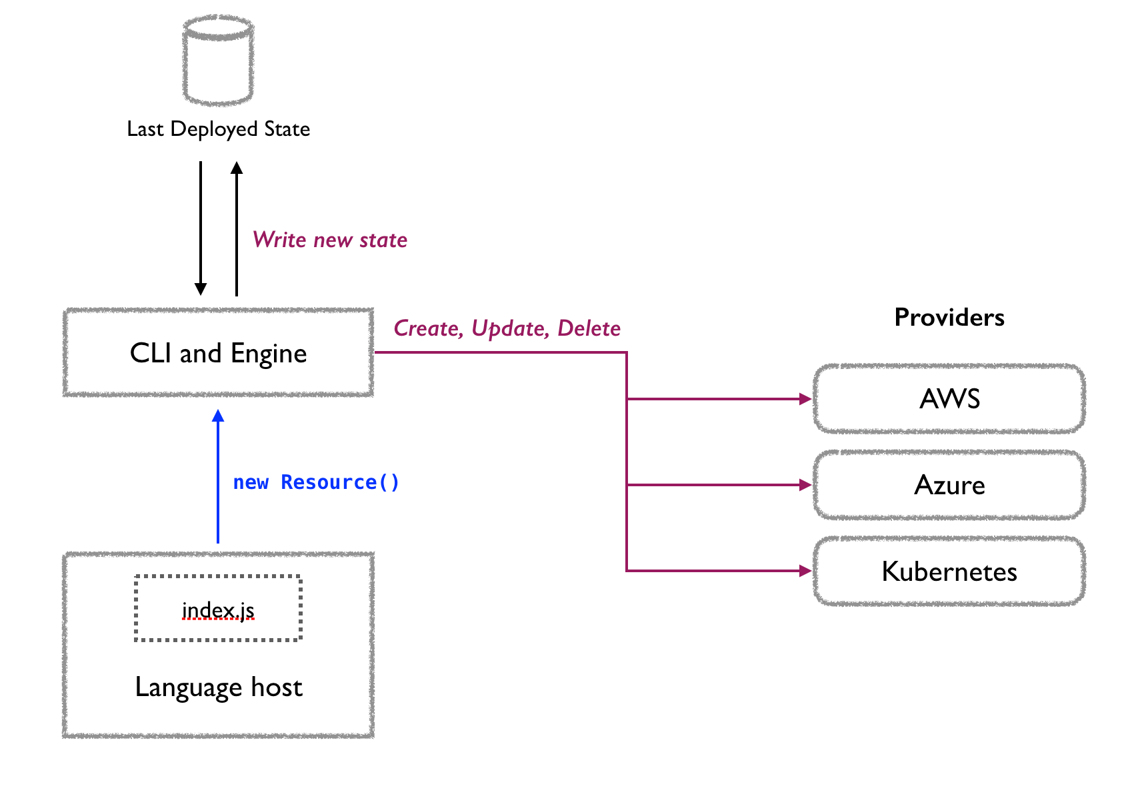
Pulumi - High Level View
Pulumi Architecture

Slide 18
Pulumi - High Level View
Pulumi Architecture
Language Host

Slide 19
Pulumi - High Level View
Pulumi Architecture
Language Host
CLI & Engine
Providers
State Backend
Pulumi Service
Cloud Storage (S3, …)

Slide 20
Pulumi - High Level View
Pulumi Architecture
Language Host
CLI & Engine
Providers
State Backend
Pulumi Service
Cloud Storage (S3, …)

Slide 21
Pulumi - High Level View
Pulumi Architecture
Language Host
CLI & Engine
Providers
State Backend
Pulumi Service
Cloud Storage (S3, …)

Slide 22
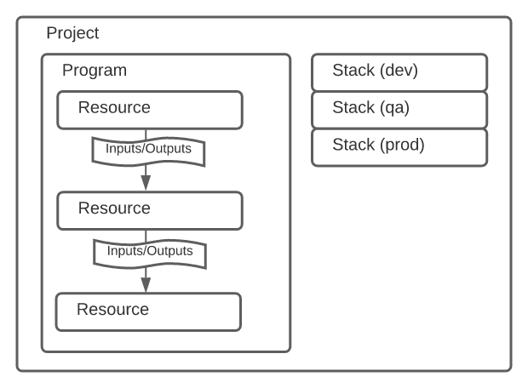
Pulumi - High Level View
Automate your infrastructure setup with one or more Pulumi projects

Slide 23
Pulumi - High Level View
Automate your infrastructure setup with one or more Pulumi projects
A project contains:

Slide 24
Pulumi - High Level View
Automate your infrastructure setup with one or more Pulumi projects
A project contains:
a program: this is your “template” from which you can create stacks

Slide 25
Pulumi - High Level View
Automate your infrastructure setup with one or more Pulumi projects
A project contains:
a program: this is your “template” from which you can create stacks
the stacks: each stack is an “instance” of the program

Slide 26
Pulumi - High Level View
Automate your infrastructure setup with one or more Pulumi projects
A project contains:
a program: this is your “template” from which you can create stacks
the stacks: each stack is an “instance” of the program
from resources: smallest building block

Slide 27
Pulumi - High Level View
Automate your infrastructure setup with one or more Pulumi projects
A project contains:
a program: this is your “template” from which you can create stacks
the stacks: each stack is an “instance” of the program
from resources: smallest building block
have inputs/outputs: read or set values for your resource

Slide 28
Pulumi - High Level View
Automate your infrastructure setup with one or more Pulumi projects
A project contains:
a program: this is your “template” from which you can create stacks
the stacks: each stack is an “instance” of the program
from resources: smallest building block
have inputs/outputs: read or set values for your resource
One project can use info from another project as input

Slide 29
Pulumi Templates

Slide 30
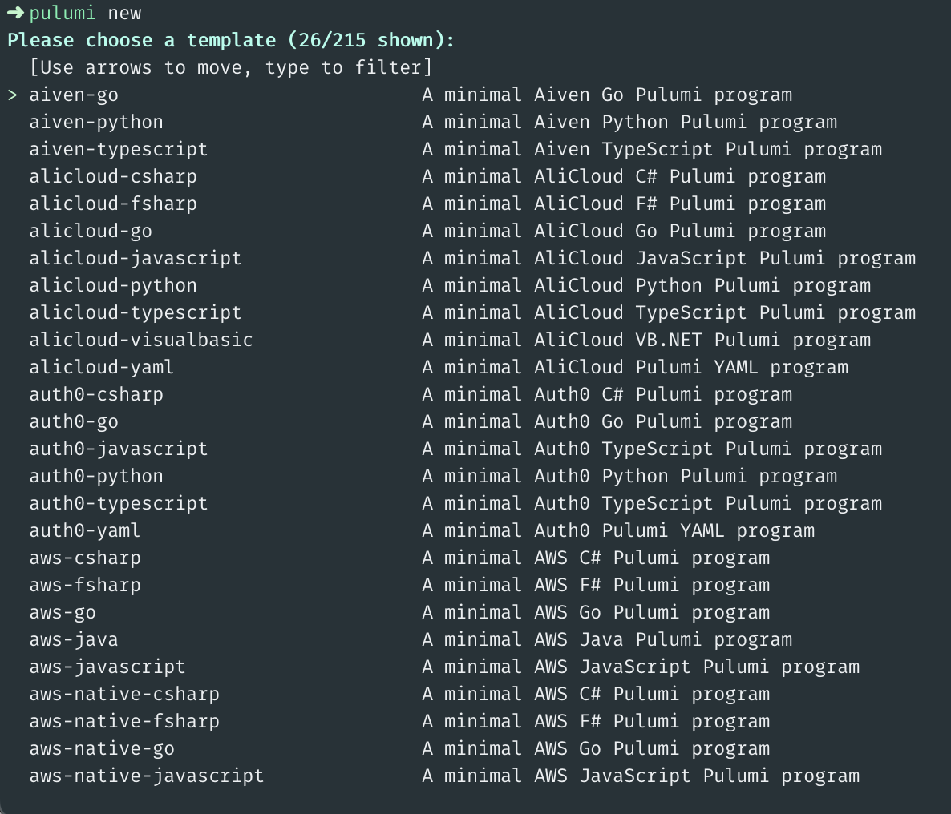
Pulumi Templates
Deploy infrastructure faster with best practices for any programming language

Slide 31
Pulumi Cloud

Slide 32
Pulumi Cloud

Slide 33

Pulumi Cloud
Built-in state and secret management

Slide 34
Pulumi Cloud
Built-in state and secret management
Pulumi Deployment

Slide 35
Pulumi Cloud
Built-in state and secret management
Pulumi Deployment
Pulumi Insights

Slide 36
Pulumi Cloud
Built-in state and secret management
Pulumi Deployment
Pulumi Insights
Pulumi Policy as Code

Slide 37
Pulumi Cloud
Built-in state and secret management
Pulumi Deployment
Pulumi Insights
Pulumi Policy as Code
Webhooks, Dashboards, and much more.

Slide 38
Pulumi Insights

Slide 39
Pulumi Insights

Slide 40
Pulumi Insights
Intelligence - Be more productive with the power of AI

Slide 41
Pulumi Insights
Intelligence - Be more productive with the power of AI
Search - Find anything in any cloud

Slide 42
Pulumi Insights
Intelligence - Be more productive with the power of AI
Search - Find anything in any cloud
Analytics - Deep insights with dashboards and export

Slide 43
Pulumi Policy as Code

Slide 44
Pulumi Policy as Code
What is it?

Slide 45
Pulumi Policy as Code
What is it?
Enforce security, compliance and best practices

Slide 46
Pulumi Policy as Code
What is it?
Enforce security, compliance and best practices
Use general purpose programming languages*

Slide 47
Pulumi Policy as Code
What is it?
Enforce security, compliance and best practices
Use general purpose programming languages*
Write expressive policies

Slide 48
Pulumi Policy as Code
What is it?
Enforce security, compliance and best practices
Use general purpose programming languages*
Write expressive policies
Enforce gated deployments

Slide 49

Demo time!

Slide 50
The Demo

Slide 51
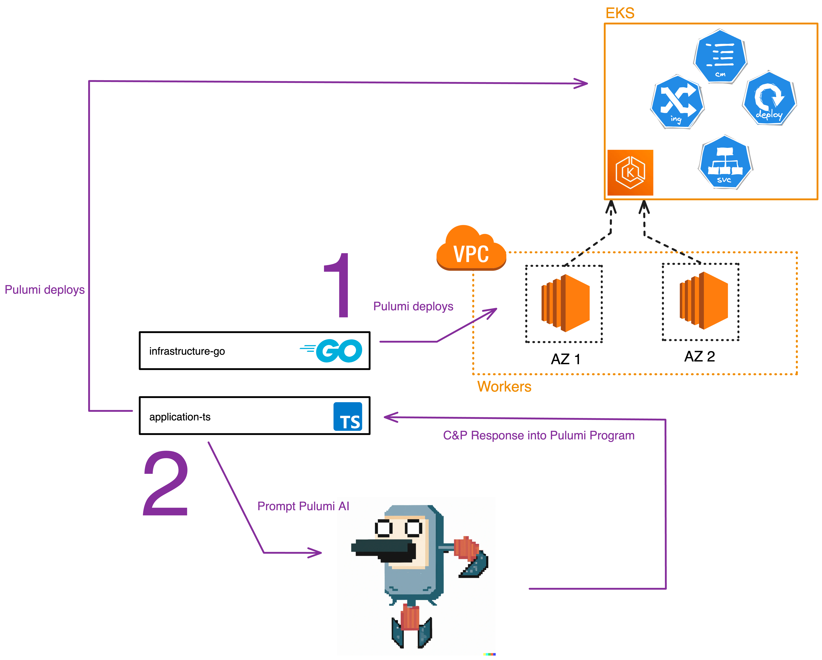
The Demo
Deployment of AWS EKS infrastructure

Slide 52
The Demo
Deployment of AWS EKS infrastructure
Using Pulumi AI to generate K8s Nginx Deployment

Slide 53
The Demo
Deployment of AWS EKS infrastructure
Using Pulumi AI to generate K8s Nginx Deployment
Deployment of AI generated workload

Slide 54
The Demo
Deployment of AWS EKS infrastructure
Using Pulumi AI to generate K8s Nginx Deployment
Deployment of AI generated workload
Language Go and Typescript

Slide 55
The Demo
Deployment of AWS EKS infrastructure
Using Pulumi AI to generate K8s Nginx Deployment
Deployment of AI generated workload
Language Go and Typescript
Bonus points: Pulumi Policy as Code

Slide 56

Wrap up!

